Slide 1
Chapter 2 Configuration Space
Chapter 3 Rigid-Body Motions
Chapter 4 Forward Kinematics
Chapter 5 Velocity Kinematics and Statics
Chapter 6 Inverse Kinematics
Chapter 7 Kinematics of Closed Chains
Chapter 8 Dynamics of Open Chains
Chapter 9 Trajectory Generation
9.1 Definitions
9.2 Point-to-Point Trajectories
9.3 Polynomial Via Point Trajectories
Chapter 10 Motion Planning
Chapter 11 Robot Control
Chapter 12 Grasping and Manipulation
Chapter 13 Wheeled Mobile Robots

Slide 2
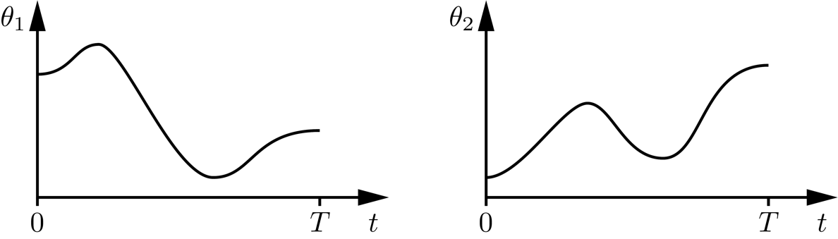
Important concepts, symbols, and equations
Trajectory: A specification of the configuration as a function of time.

Slide 3
Important concepts, symbols, and equations (cont.)
Path: A specification of the configuration as a function of a path parameter.
Time scaling: A mapping s(t): [0, T ] → [0, 1], from time to the path parameter.

Slide 4
Important concepts, symbols, and equations (cont.)
Motion as a function of 𝜃(s) and s(t):
Both 𝜃(s) and s(t) must be twice-differentiable.

Slide 5
Important concepts, symbols, and equations (cont.)
straight line in joint space
straight line in task space

Slide 6
Important concepts, symbols, and equations (cont.)

Slide 7
Important concepts, symbols, and equations (cont.)
Third-order polynomial time scaling

Slide 8
Important concepts, symbols, and equations (cont.)
Fifth-order polynomial time scaling

Slide 9
Important concepts, symbols, and equations (cont.)
Trapezoidal time scaling

Slide 10
Important concepts, symbols, and equations (cont.)
S-curve time scaling

Slide 11
Important concepts, symbols, and equations (cont.)
Polynomial interpolation through via points
third-order interpolation using via times, configurations, and velocities
third-order interpolation using via times, configurations, and equal velocities and accelerations before and after vias
Many other methods, including B-splines (paths stay within convex hull of control points, but don’t pass through them).

Slide 12
Give an expression for the path 𝜃(s), s ∈ [0,1].
𝜃₂
3
𝜃(1)
1
𝜃(0)
1
4 5
𝜃₁

Slide 13
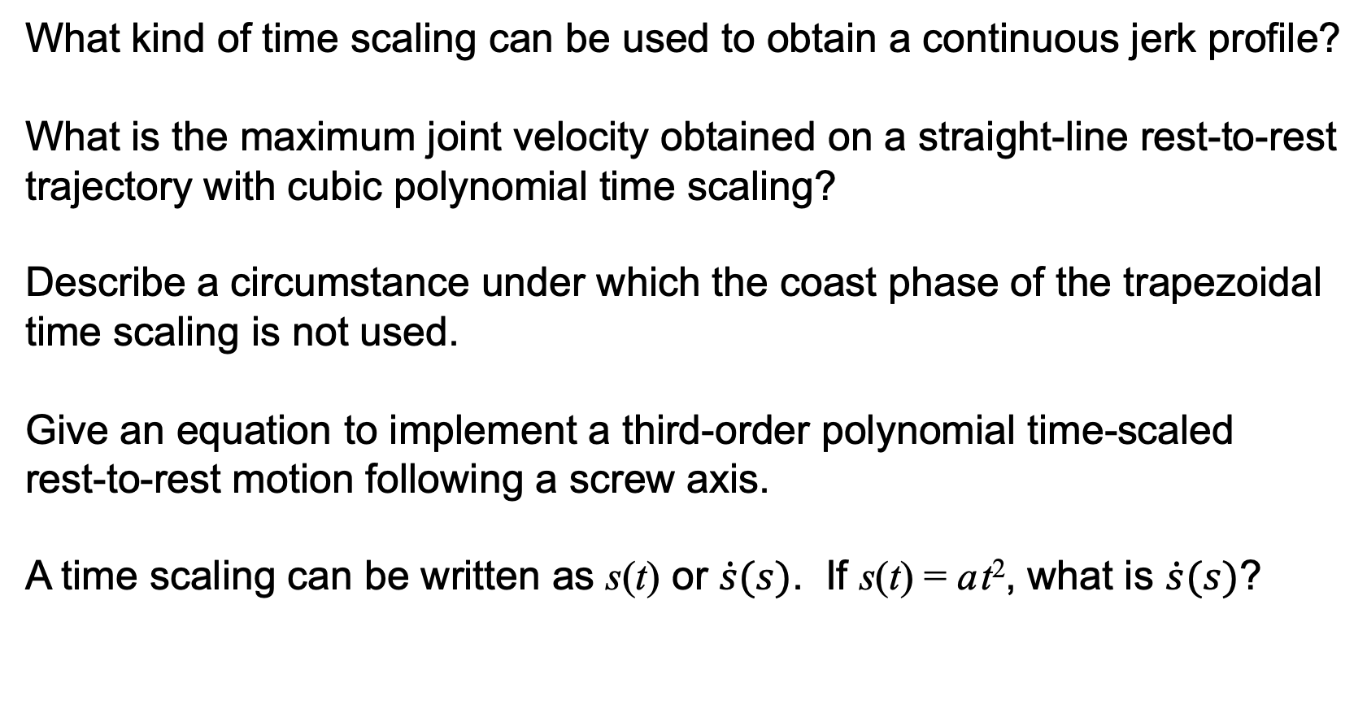
What kind of time scaling can be used to obtain a continuous jerk profile?
What is the maximum joint velocity obtained on a straight-line rest-to-rest
trajectory with cubic polynomial time scaling?
Describe a circumstance under which the coast phase of the trapezoidal
time scaling is not used.
Give an equation to implement a third-order polynomial time-scaled
rest-to-rest motion following a screw axis.
A time scaling can be written as s(t) or $\dot{s}(s)$. If s(t) = a t², what is $\dot{s}(s)$?

